Slide 1
OER Writing
CDR Jeffrey Taylor
Chief, Officer Career management Division

Slide 2
Agenda & Objectives
AGENDA
Present/review OER instructions & resources
Discuss Rated-On officer ←→ Supervisor relationship
Cover the elements of OER statements
Show examples of OER writing
OBJECTIVES
Rated-On Officers have a strategy on how to get your OER done
Supervisors are provided guidance on setting expectations for OERs
Identify the elements of a good OER statement
Practical experience writing OER statements
Notes:
Agenda - what we’re going to cover today
Objectives - the takeaways from today’s lesson

Slide 3
Official OER Resources
CPC website - Officer Evaluation System
https://www.corpscpc.noaa.gov/careermgmt/evaluation.html
Officer Evaluation System instructions: https://www.corpscpc.noaa.gov/procedures/persmanual/ncch10_pm.pdf
CPC website “How-To” Guidance & FAQs: https://www.corpscpc.noaa.gov/cpchome/howto_guidance.html
NOAA Corps Leadership Development Framework: https://www.corpscpc.noaa.gov/careermgmt/pdf/Leadership%20Development%20Framework.pdf
Notes:
These are some of the official guidance on the OER process.
Mention/show other books that help with verbiage

Slide 4
Official OER Resources
“Top Ten” Tips for Ensuring OERs will Clear CPC Review
https://www.corpscpc.noaa.gov/careermgmt/pdf/10_reasons_oers_invalid.pdf
Supervisor’s Guide to NOAA Corps Officers https://www.corpscpc.noaa.gov/procedures/index.html

Slide 5
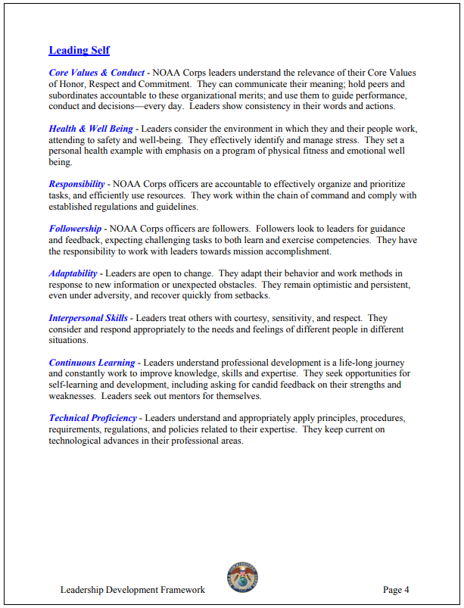
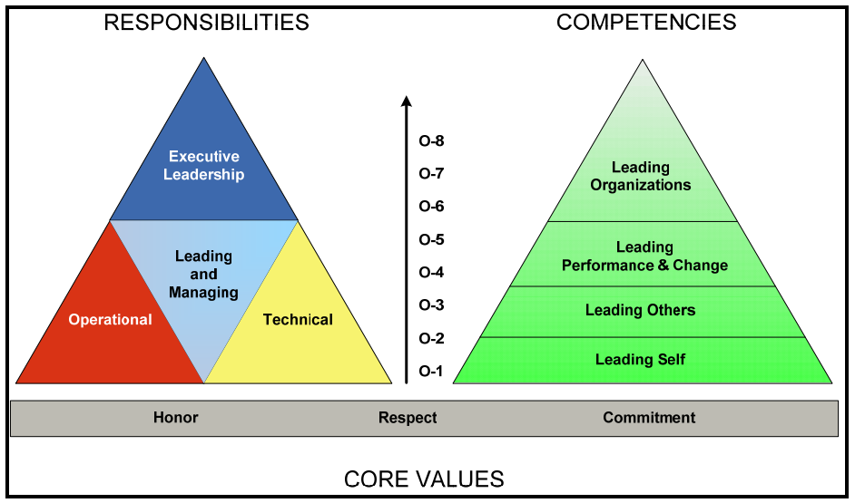
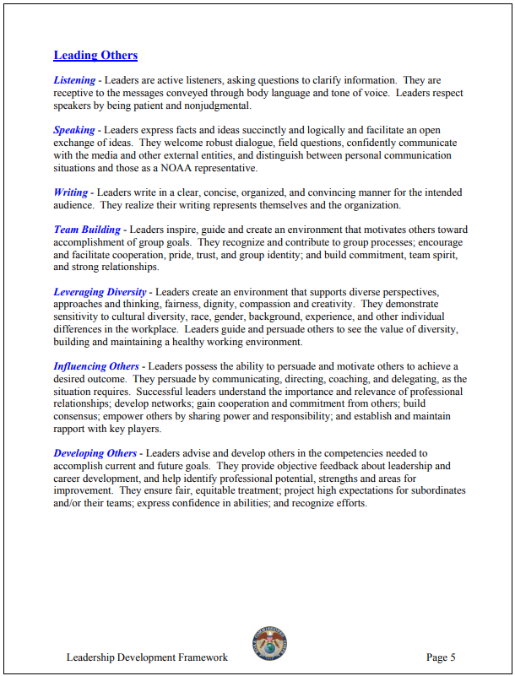
Official Resources
NOAA Corps Leadership Development Framework: https://www.corpscpc.noaa.gov/careermgmt/pdf/Leadership%20Development%20Framework.pdf
Notes:
These are some of the official guidance on the OER process. The Leadership Development Framework has helpful info on progression, useful verbiage. Tie in the competencies for the level of the rated on officer to what you’re evaluating on and writing about. Take a good look at the organizational goals as well. If you can tie your actions/impact to the goals of the organization, you should do well.

Slide 6
Your part in the process
What does the OER instructions say about the Rated-On Officer’s responsibilities?
What does your supervisor want?
How do you figure that out?
Notes:
OER instructions say to fill out section 1 & maybe section 2. DEFINITELY FILL OUT SECTION 1.
But get w/ your supervisor to understand how they want your input.
Write your own OER! Make it easy on your supervisor **OR** Make sure you know what your supervisor’s expectations are for OER submissions
Next slide is from the FAQs about writing your own OER

Slide 7
From CPC Website FAQs
“It is pretty standard practice for officers to be asked to write their own OERs (including scores), particularly in land assignments supervised by busy senior officers or civilians. Is this consistent with CPC's intent?”
The Directives clearly state that it is the responsibility of the reporting and reviewing officer to compose the OERs for the Reported-On Officer. Every officer is expected to provide his/her supervisor with accomplishments for the reporting period and it is highly recommended that this list include specific details with regard to impact as a result of his/her performance. The practice described in the above question is recommended as a draft process to assist Junior Officers with learning the skills to write effective OERs. This practice does not preclude the responsibility of the Supervisor, Reporting or Reviewing Officers.
Notes:
However, see this as an opportunity to:
Get better at crafting OER bullets to effectively convey the importance and impact of the work you are doing.
Paint the best picture of yourself and take some work off of your rating chain members’ plate.

Slide 8
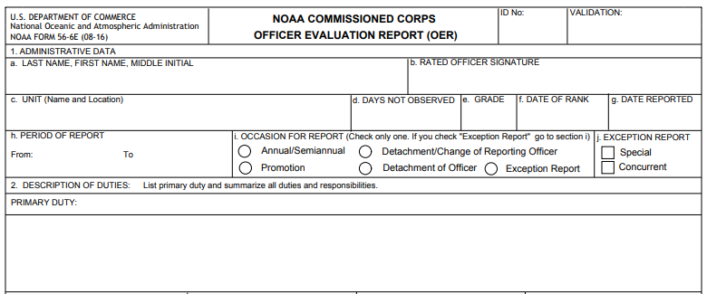
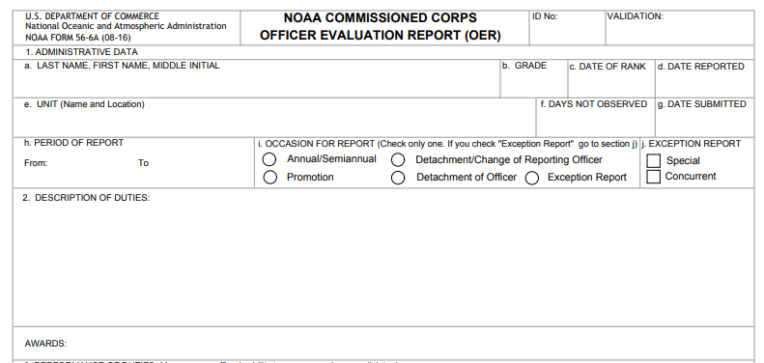
ENS & LTJG
LT to CAPT
Notes:
Fill out section 1 & 2. Make sure you get your dates correct, Days Not Observed (most common for PCS). Unit NAME & LOCATION. CAPITALIZE your job title. Resources for section 2: billet description, ask previous officers.
10.A.5.a. For LT & above - section 1. Section 2 is RO or SUP but I suggest that the RO does it
10.A.5.b. For ENS & JO - section 1. Section 2 is SUP but I suggest RO does it
Meet your deadlines (makes it easy for your SUP & it’s part of the scoring criteria (5f))
I recommend downloading a new form every time you begin an OER. We have experienced corrupted forms when submitted to CPC. Any time there is an issue with the forms that are submitted, it only slows the processing down. It is difficult enough to get all the signatures once, the delay seems exponential for subsequent submissions.
I have heard comment that the ENS OERs are somewhat irrelevant, as the promotion mutiplier for JG is 100%. If you meet the requirements, you are selected. However, the precept letters for LT say look at 5 years back at the least. This usually incorporates the ENS OERs. Don’t let a good officer get passed down the road because of the attention given to these early OERs. Also, feedback is important at all stages of a career.

Slide 9
3 Performance Dimensions
Notes:
Click on Open button. Assign your numerical ratings. Logic would dictate you choose the categories that the Officer rated the highest. Advocate for your Officers. Describe the actions that have made them stand out.

Slide 10
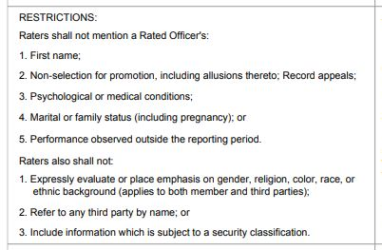
Read the Instructions

Slide 11
METRICS METRICS METRICS!
As ship’s cashier - $ amount of funds responsible for, $ of payments made over X months to # crew
Movies cataloged and organized
ECO rounds done, trainings put on
$ of purchases made on purchase card supporting X departments
Fire stations, extinguishers, SCBAs, DC lockers, all inspected each month
# charts maintained, nav plans created & briefed
# Welcome Aboard briefs done to X science parties
# of sea service letters written
# of Ship Specific Instructions written
Maintained a formulary of X items, responded to # sick calls and/or emergencies
Notes:
Not just u/w stuff to keep track of. Many other collateral duty metrics

Slide 12
Accomplishment (w/ metrics) + Impact
How well was the task done?
Was it captured as a concise accomplishment?
What were the results of the accomplishment?
What was the demonstrated impact?
SO WHAT?
Notes:
The elements of a good OER statement.
Does it answer the question, “SO WHAT?”

Slide 13
Ways to Save Space
No double space after periods
Be creative in shortening words & using symbols:
And = &
For example = e.g.
That is = i.e.
With = w/, Without = w/o, within = w/in
Regarding = re:
No need to use full name or even a subject in your statements
Liberally use abbreviations, but define them first if they’re not common.
Remember your audience! What you think is common may not be
Shorten numbers: 1000 = 1K, $3.75 million = $3.75M
Use the active vs. passive voice
https://owl.purdue.edu/owl/general_writing/academic_writing/active_and_passive_voice/active_versus_passive_voice.html

Slide 14
Example, Good?
3a,b,c,d,e. Chair, Project Review Board (PRB): continued to use project management as a tool to monitor NOS efforts and effectively & efficiently utilized people and funding. Impact: originally goal #5 of NOS' 10-Year Strategic Plan to completely adopt project management - it was removed in the updated plan since it was 100% successfully accomplished. 3a,c,e. Created government shutdown checklist for NOS Leadership from being boots on the ground as Acting Director. Impact: will be used for future shutdowns in order to better position NOS for a smooth transition of employees from and back to government.

Slide 15
Example, Good?
Respected by her peers and known to offer willing assistance, displaying confidence and aptitude for direction. She is sought out for advice by other officers in many situations. She carries responsibility with tact and readily accepts challenges, inspiring others to rise to the occasion. In this past year, she took initiative in a new assignment and billet, overcoming obstacles and piloting the development of multi-dimensional projects. She stewards resources and proficiently maintained the office as the only exempted employee during the government shutdown. Entrusted to be a self-starter, she paves the way for future officers to occupy her current billet. An upright officer who raises those around her with enthusiasm and positivity, providing an atmosphere that fuels productivity and diffuses stressful settings.

Slide 16
Example, Good?
Oversaw a 7 month $3.4 M unscheduled dry dock period to repair both propulsion motors. Kept morale high and continued to accomplish necessary shipboard tasks. Upon completion of repairs, ship achieved a 90% DAS completion rate missing only 16 days, 12 of those attributed to science program or weather. Platform reliability rebuilt and increased the reputation of OMAO with NMFS.
Utilized prudent seamanship and cruise planning to navigate Hurricane Florence. Lone vessel operating in the north Atlantic that remained on effort during catastrophic weather event. Allowed MOC-A to direct efforts elsewhere with continued support of program needs.

Slide 17
Make an OER statement
On Fairweather, LTJG Hydreaux was one of 4 qualified OODs and the senior-most ENS during this rating period. He stood watch with 2 JOODs and taught them shiphandling, station keeping, pilotage, confined waters navigation, small boat launch and recovery for the first 4 months of the field season. This led to those 2 OODs becoming qualified on time. He was a launch coxswain and helped out during a time when the deck department was short staffed.
A leader to 2 JOODs, expertly trained them on bridge watchstanding skills (e.g., shiphandling, station keeping, confined water pilotage & navigation, small boat launch & recovery) over 4 months. Their on-time qualification resulted in a 50% increase in OODs resulting in flexible watch bill scheduling & ability to rotate officers on leave w/o augmenters. As launch cox’n, he alleviated a shortage in the deck dept, thus dramatically improving data acquisition 30-50%.

Slide 18
Make an OER statement
LT Green was the Environmental Compliance Officer. She ensured department heads kept up with their necessary ECO logs (deck maint., gray water, routine visual insp.), hazmat inventory of 1133 items, NPDES update. She developed scenarios and led 3 ECO drills on a variety of hazards (oil, coolant, particulates). She presented annual HAZCOM/Right to Know training to 22 crew members. During 2 actual incidents, she was on scene leader, directed the response, and prevented hydraulic oil from going overboard. As per reporting guidelines, filled out and submitted corrective action assessment.
As ECO, maintained 3 critical logbooks, updated NPDES per regulations. Built rapport w/ & cooperation from dept heads to accurately complete the annual HAZMAT inventory of 1133 items. Led 3 ECO drills on a variety of hazards, did HAZCOM training for 22 crew; resulted in greater crew safety & emergency response ability. Was On-Scene Leader during 2 hydraulic hose failures; rapid & proper response resulted in no oil discharged to sea. Promptly met all after-action reporting requirements for leadership’s awareness.

Slide 19
Make an OER statement
ENS Sloth has been late to watch 3 times. The 1st time was on his 1st trip out and he didn’t realize that his cell phone didn’t switch over from Central time to Eastern time when the ship’s clocks were moved ahead. He was told to make sure of this and set his time manually on his phone. The 2nd time was 2 weeks later when his battery died overnight because he didn’t recharge his phone. He was counseled against using his phone as an alarm clock and the ship bought him a battery powered alarm clock. The 3rd time was 1 week later because he didn’t use his new alarm clock and continued to use his phone. This time he had the alarm time set correctly, but didn’t enable it.
Issues w/ time management, following instructions, & attention to detail. Reported to watch late 3 times over 4 weeks. Failed to follow through with remedial actions despite being given accommodations & ample opportunities to correct habits.

Slide 20
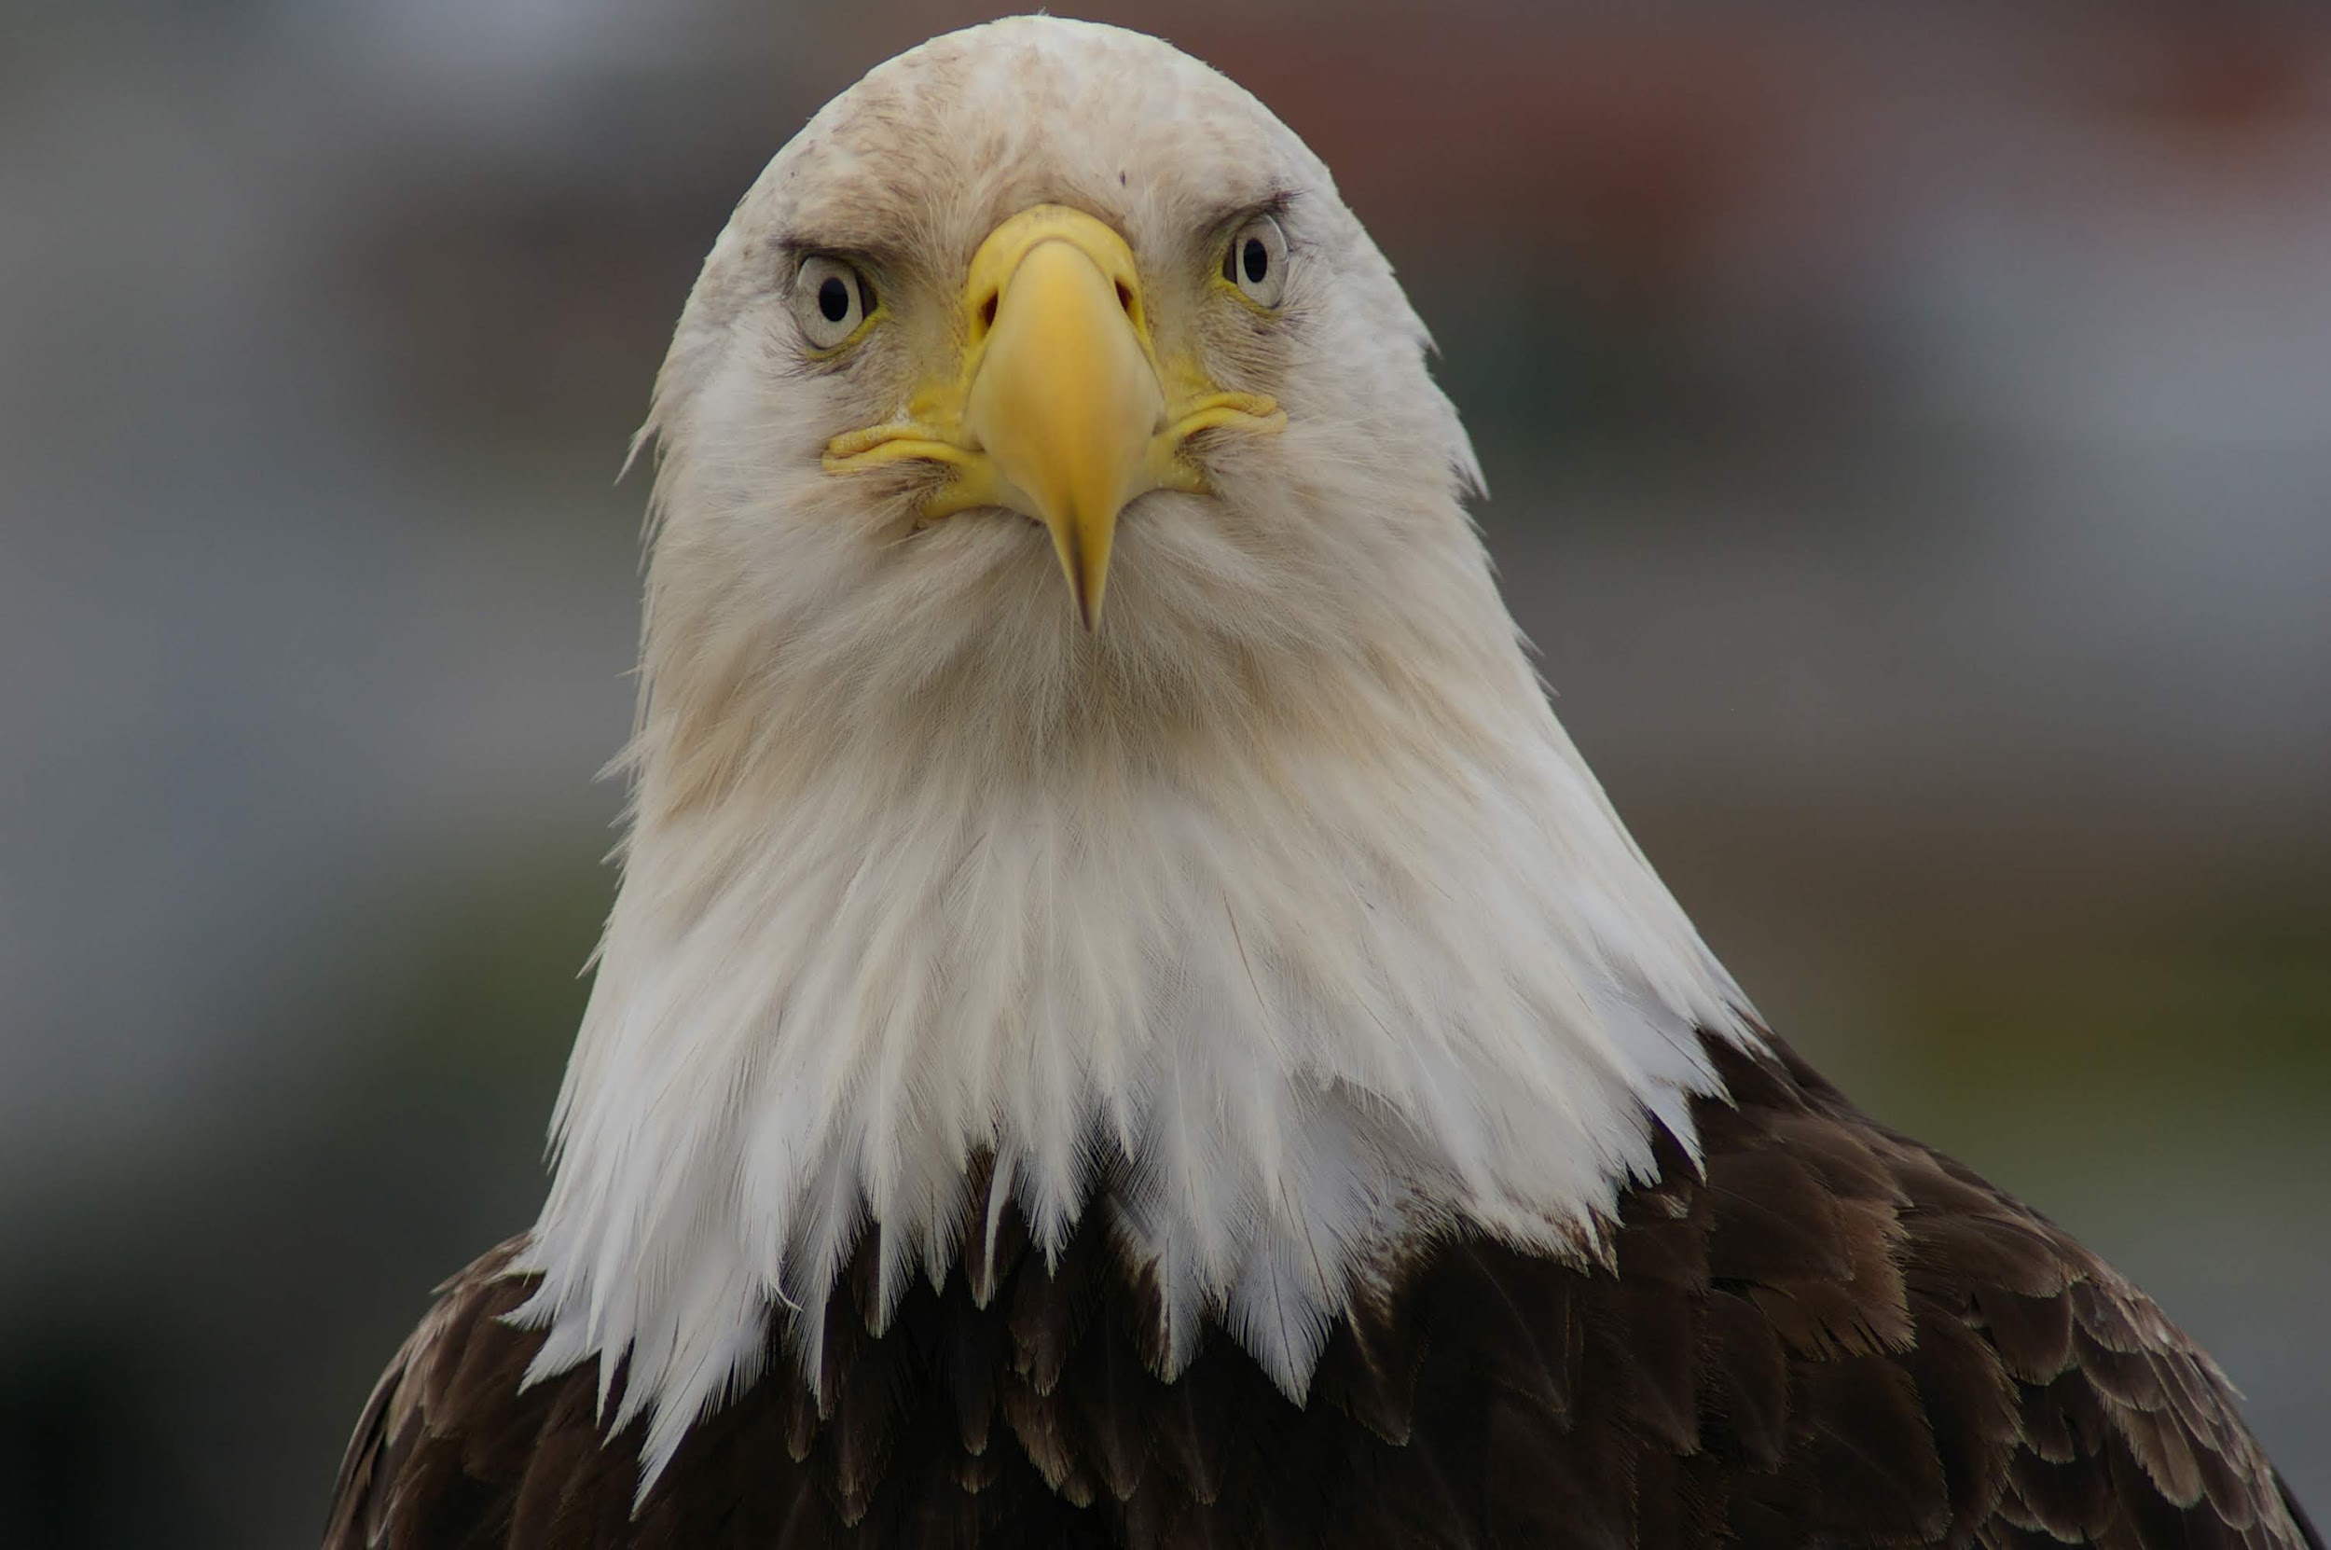
QUESTIONS?

Slide 21
Notes:
Go over notes from beginning of “what do you want to get out of today’s lesson?”

